Slide 1

Blindness Detection
Detect diabetic retinopathy to stop blindness
before it's too late
0852603 朱愷擇
0613144 葉之晴
309653008 楊大昕

Slide 2
Outline
01
Introduction
02
Materials & Methodology
03
Experiment
04
Discussion
05
Conclusion

Slide 3
PART 01
Introduction
Illustrate the motivation and the purpose of our project.

Slide 4
Introduction
In Taiwan, more than two million people have diabetes.
Diabetes can cause many health complications.
Ex: Diabetic nephropathy, diabetic retinopathy.
The eye is the window of the soul.
Millions of people suffer from diabetic retinopathy globally.
The leading cause of blindness among working aged adults.
Notes:
在台灣，超過200萬人患有糖尿病，大約一成。
糖尿病會造成許多健康問題，比方說 糖尿病引起的腎病、糖尿病引起的是網膜病變。
眼睛是靈魂之窗。
全世界，樹子百萬計的人備受糖尿病引起的視網膜病變之苦，這也是在工作年齡的成年人造成失明的主要原因。

Slide 5
PART 02
Materials & Methodology
Introduce the dataset and the methods we used.

Slide 6
Materials
Aravind Eye Hospital in India hopes to detect and prevent this disease among people living in rural areas.
Aravind technicians travel to rural areas to capture images and then rely on highly trained doctors to review the images and provide diagnosis.

Slide 7
Materials
Their goal is to scale their efforts through technology.
Gain the ability to automatically screen images for disease.
Provide information on how severe the condition may be.

Slide 8
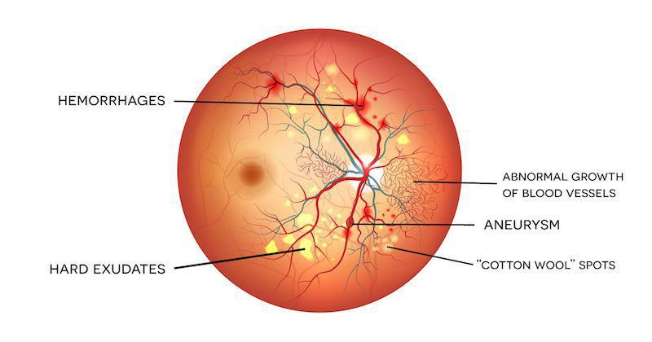
Methodology
We can spot on five things to know diabetic retinopathy.
出血
動脈瘤
滲出液
棉絮狀滲出點

Slide 9
Methodology
3662 training images and 1928 testing images.
Each image has been rated on a scale of 0 to 4.
Label | Stage
0 | No DR
1 | Mild
2 | Moderate
3 | Severe
4 | Proliferative DR

Slide 10
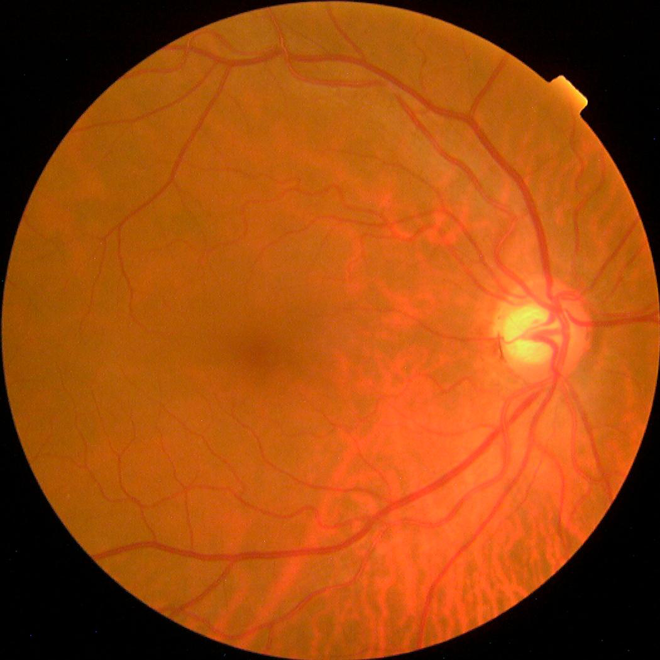
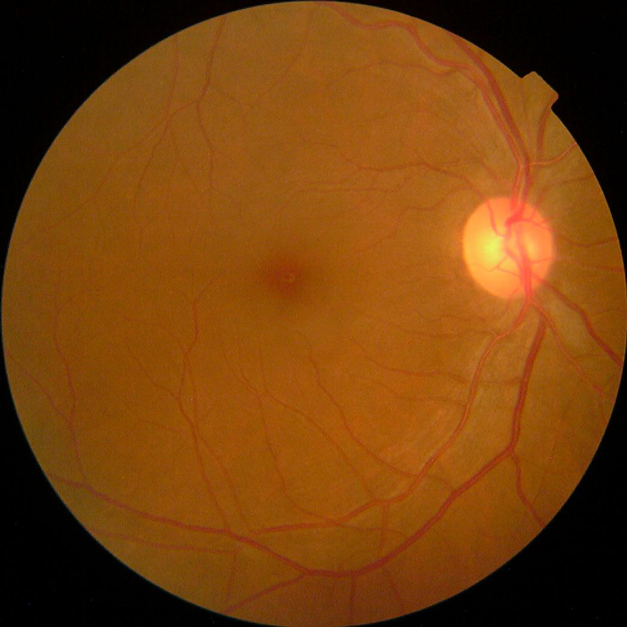
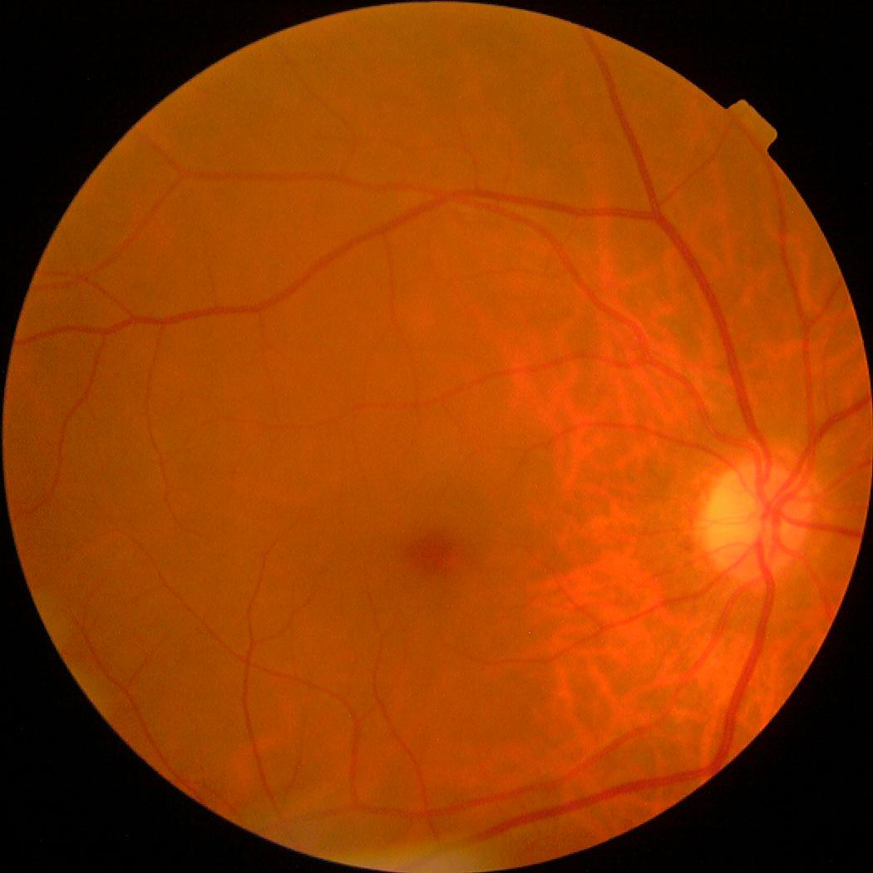
Methodology
Original images are taken using fundus photography.

Slide 11
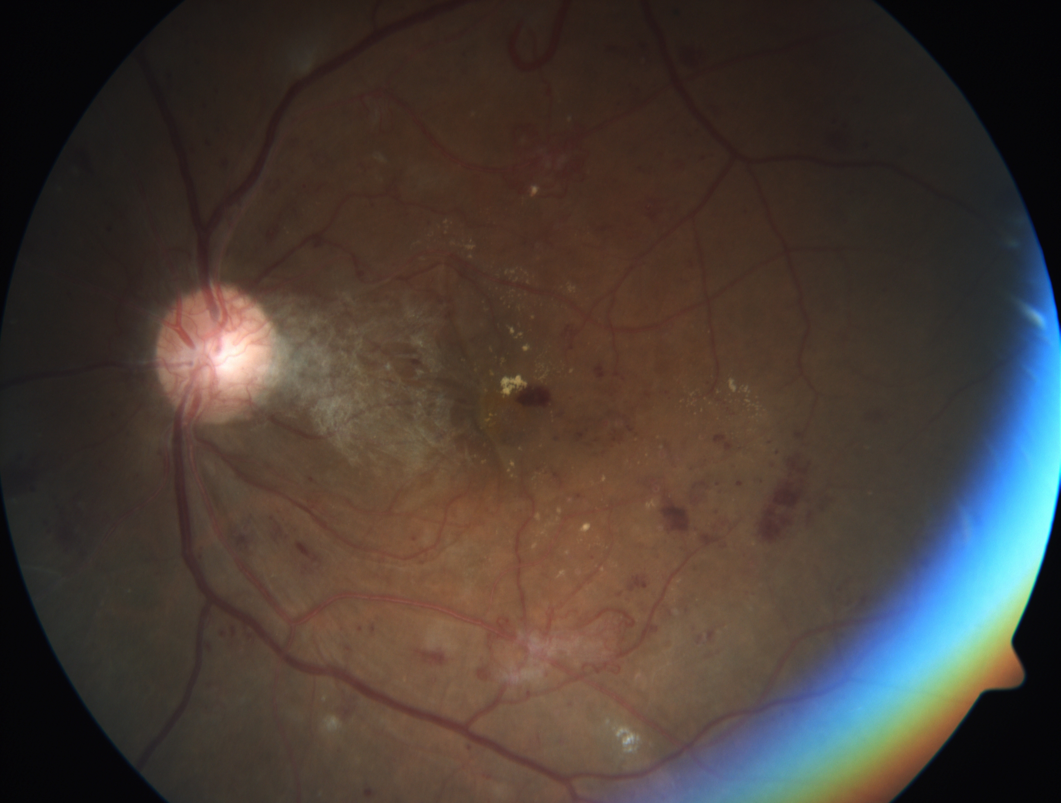
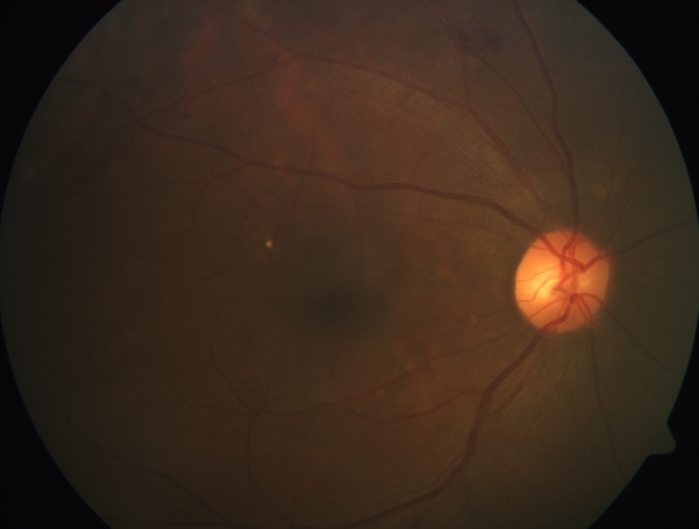
Methodology
Some images are taken under a bad condition.
Ex: Out of focus, underexposed, or overexposed.

Slide 12
Methodology
We want to know if its good for prediction if we do some pre-processing to original images.
Split 20% training data as validation data.
2929 training data
3663 training data
733 validation data

Slide 13
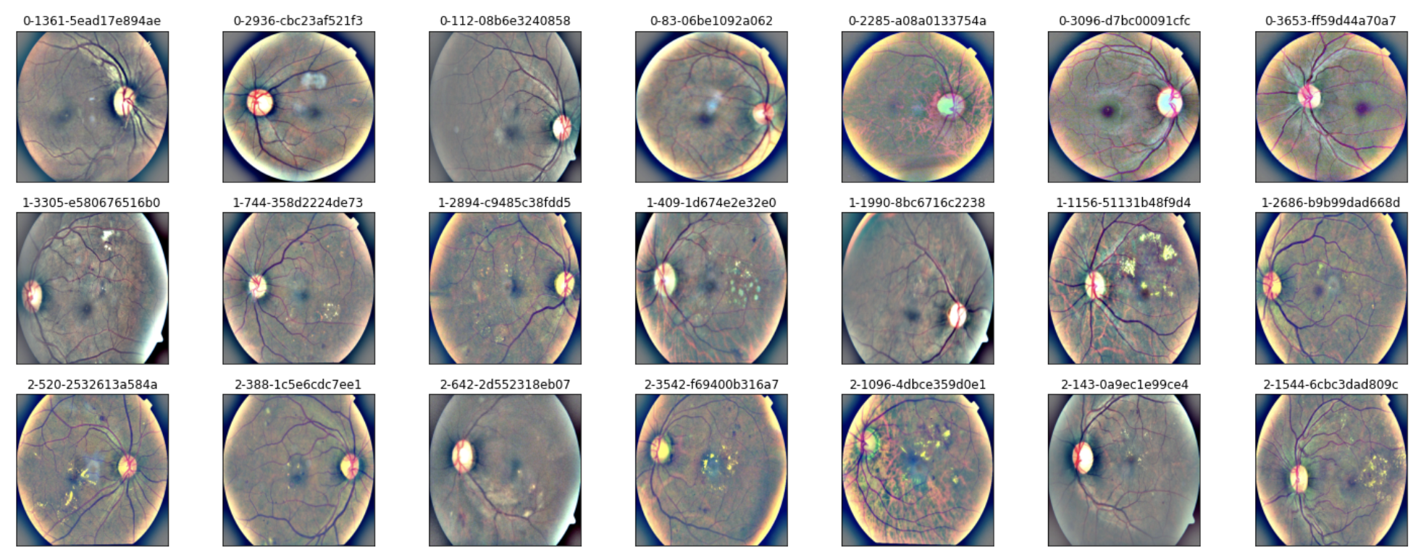
Methodology
Use cv2.addWeighted() to merge the original image and GaussianBlured image, and improve lighting condition.

Slide 14
PART 03
Experiment
Use pre-trained model to classify and show the result.

Slide 15
Experiment
Model: Resnet_v2 model
Loss function: Cross Entropy
Optimizer: Adam
Learning rate: 5e-6
Epoch: 30

Slide 16
Experiment without pre-processing
Use original images to train the model.

Slide 17
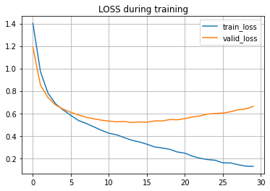
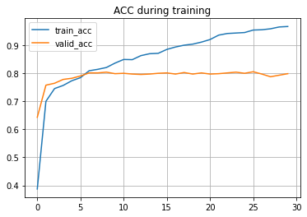
Experiment without pre-processing
without | Loss | Accuracy
Training | 0.128120 | 0.966200
Validation | 0.518663 | 0.804911

Slide 18
Experiment with pre-processing
Use pre-processed images to train the model.

Slide 19
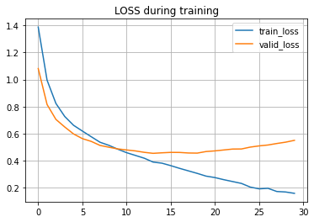
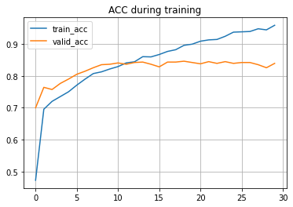
Experiment with pre-processing
with | Loss | Accuracy
Training | 0.157332 | 0.958348
Validation | 0.453608 | 0.845839

Slide 20
PART 04
Discussion
Compare two results

Slide 21
Discussion
without | Loss | Accuracy
Training | 0.128120 | 0.966200
Validation | 0.518663 | 0.804911
with | Loss | Accuracy
Training | 0.157332 | 0.958348
Validation | 0.453608 | 0.845839
+5%

Slide 22
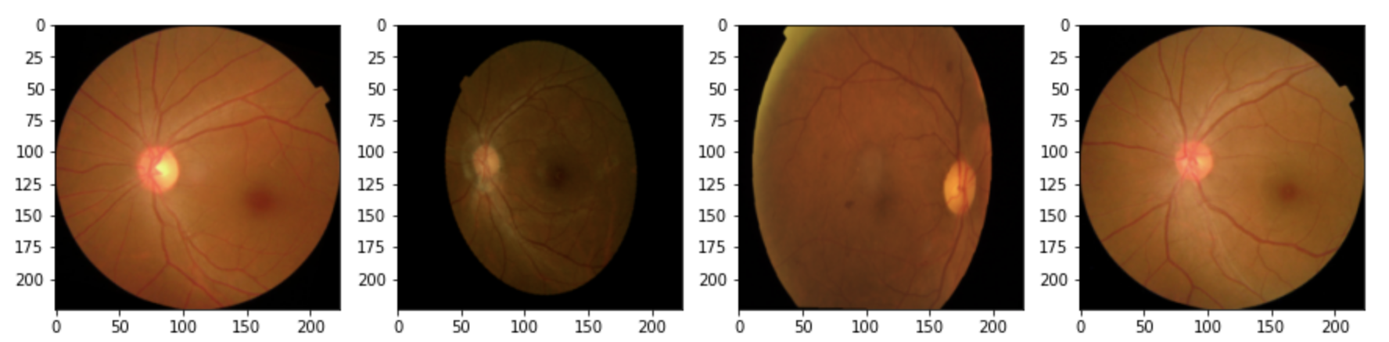
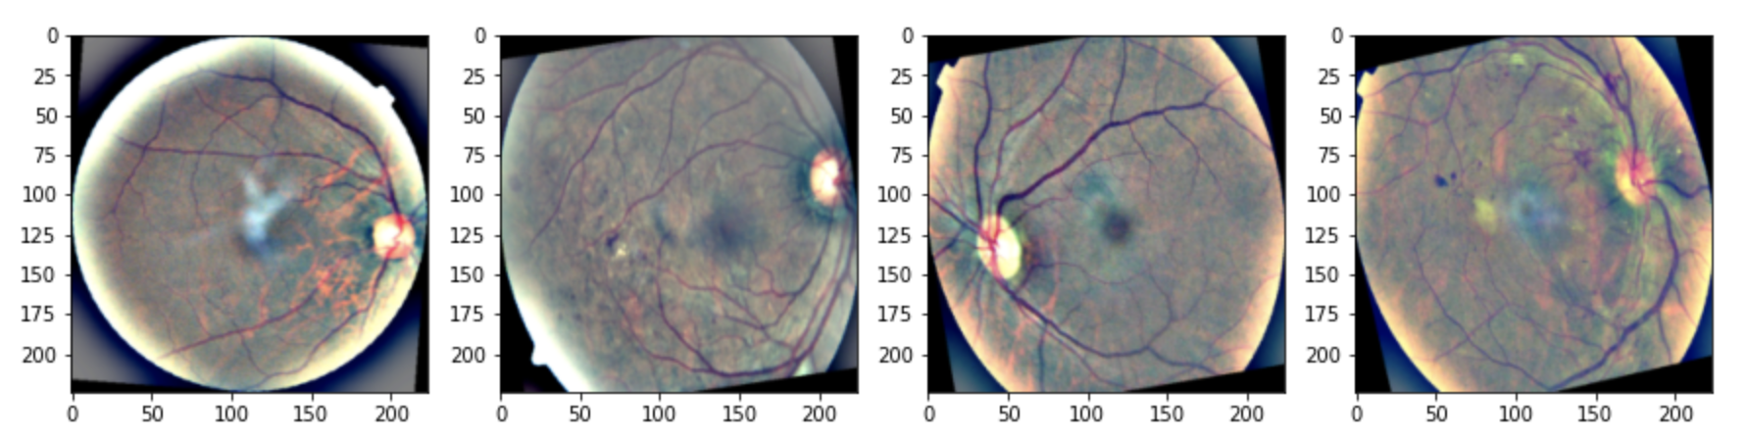
Discussion
Notes:
判斷ＤＲ的階段主要是透過剛剛題到的那五個點，眼底的顏色大多數都是橘黃色、紅色，對電腦來說，電腦並不會知道影像中血管的紅色與背景的橘色是不相近的。
所以透過 跟 高斯濾波 結合，明顯地將背景的橘色改成跟紅色的血管、露出的液體不同的顏色，方便讓電腦能夠抓到特徵的部分，讓模型的預測效果更好。

Slide 23
PART 05
Conclusion
Make a conclusion of this project.

Slide 24
Conclusion
We are usually provided data under bad condition.
Thus, we must do some pre-processing to the provided data,
either image data or numerical data.
It is not only for cleaning data, but also for improving the ability of model prediction.
Proper pre-processing is better for feature extraction.
Notes:
通常我們拿到的資料都是不乾淨的資料，
因此我們需要對資料作前處理，不管是 影像資料或是數值資料，
這不只是要清理資料，也是為了要提升模型的預測能力。
適當的前處理對於特徵抓取更好。

Slide 25
Thanks for listening

